Slide 1
CUSTOMER SHOPPING BEHAVIOR / LEADERSHIP REVIEW
Customer shopping behavior:
the $60 center of gravity
Where the assortment is healthy, where mix is concentrated, and which merchandising moves are most actionable.
DESCRIPTIVE READOUT · CATEGORY, SEASON & ITEM MIX

Slide 2
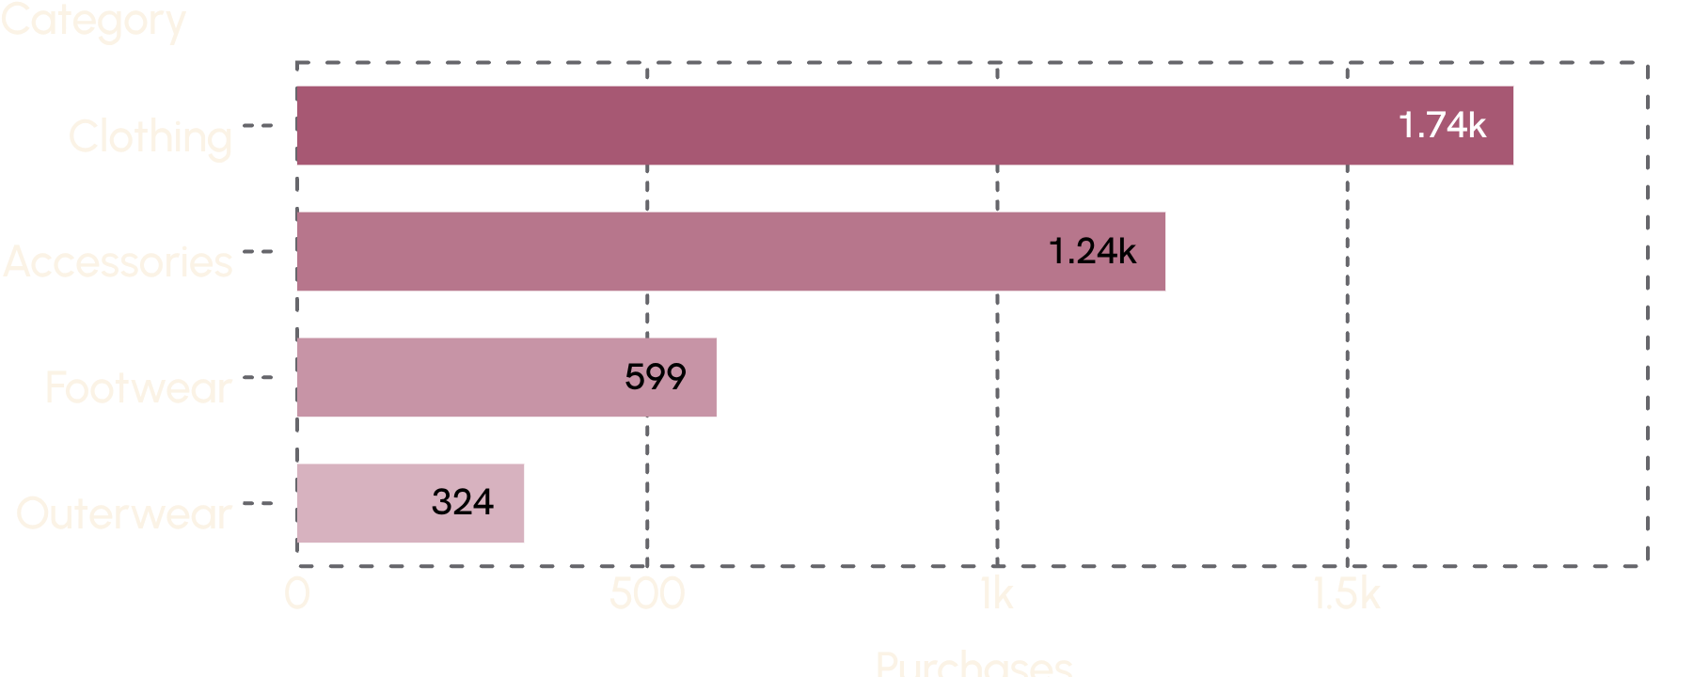
01 — CATEGORY MIX
Category mix is broad, but clothing carries the business
Clothing and accessories together make up the clear majority of purchases.
Purchases
Clothing: 1,737 purchases
Accessories: 1,240
Footwear: 599
Outerwear: 324
Purchases by category · 3,900 purchase records in the supplied file
Customer shopping behavior: the $60 center of gravity
2

Slide 3
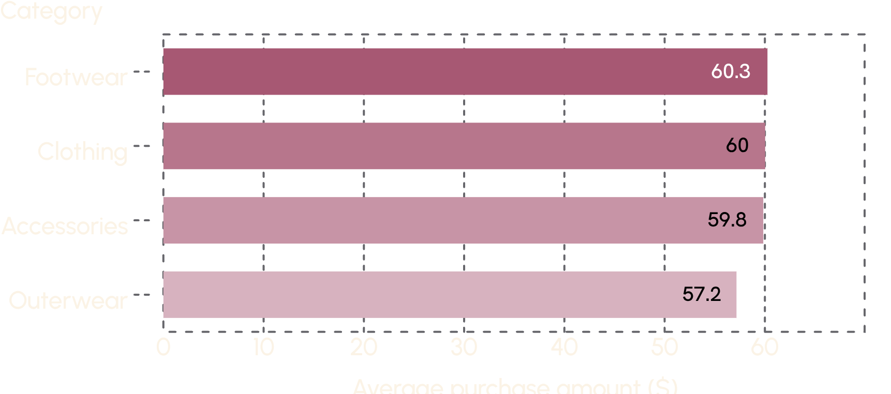
02 — BASKET VALUE
Spend is remarkably flat across categories
The category mix changes volume more than basket value.
AVERAGE PURCHASE
$59.76
Overall average purchase
Footwear $60.26
Clothing $60.03
Accessories $59.84
Category averages
Outerwear $57.17
Category spread: $3.09 from highest to lowest
Customer shopping behavior: the $60 center of gravity
3

Slide 4
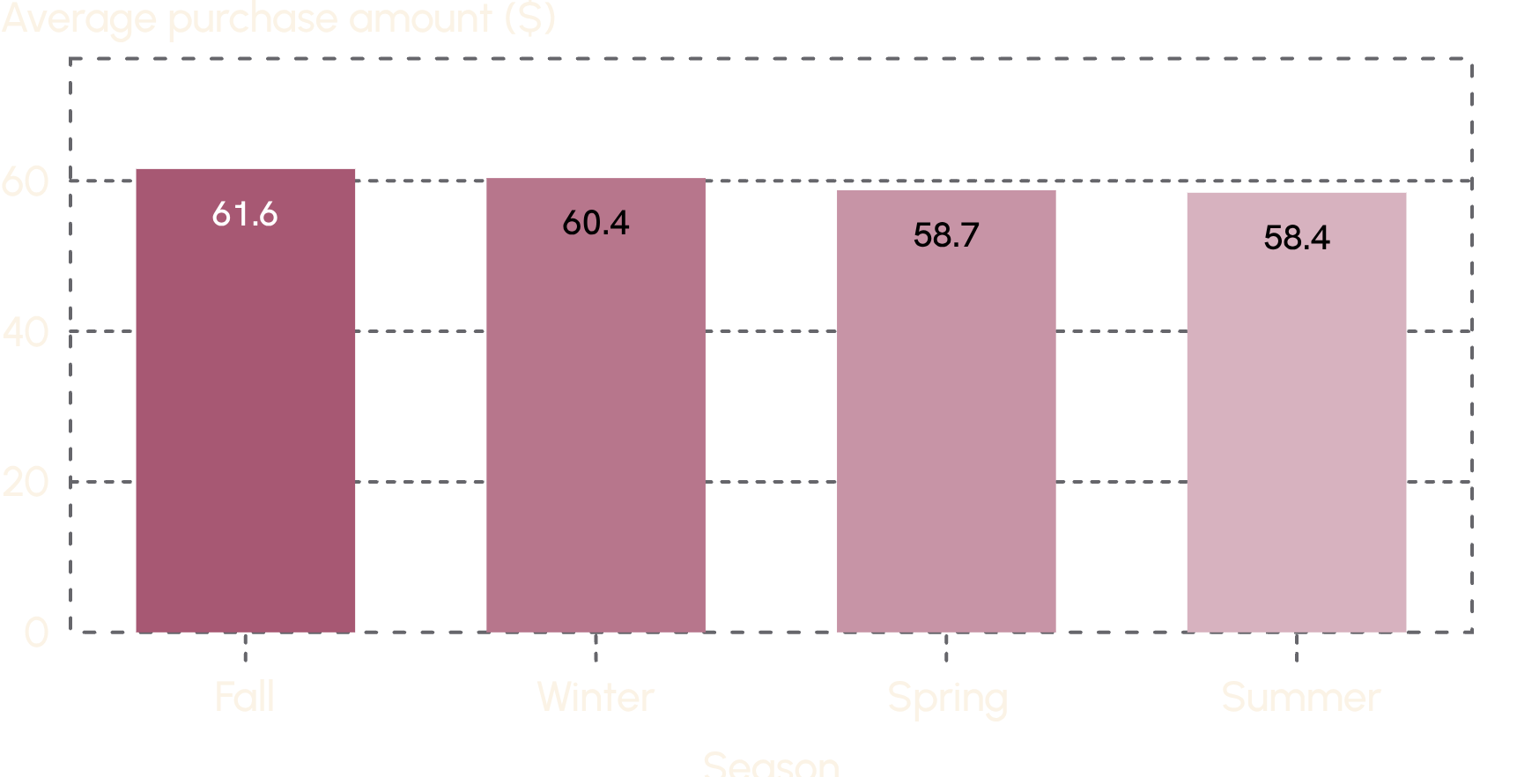
03 — SEASONALITY
Fall is the strongest selling season
Fall outperforms summer by $3.15 on average.
PLANNING SIGNAL
Use fall as the anchor for larger seasonal stories and bundles.
Average purchase amount by season
Customer shopping behavior: the $60 center of gravity
4

Slide 5
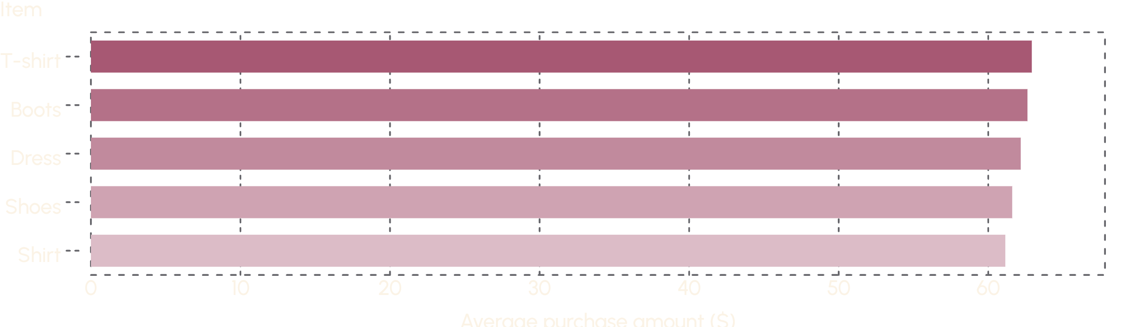
04 — ITEM WINNERS
Product winners are distributed, not concentrated
The top five item types sit within a narrow $1.77 band.
MERCHANDISING READ
Prioritize a portfolio of winners instead of a single hero SKU.
Top items by average purchase amount
Customer shopping behavior: the $60 center of gravity
5

Slide 6




05 — WHAT TO OPTIMIZE
Merchandising should optimize mix and timing, not chase price
The data points to where to place attention, not where to force a higher ticket.
Protect scale
Time the story
Clothing and accessories provide the scale.
Fall is the clearest seasonal upside.
Build the basket
Hold the line
Footwear is a useful cross-sell and basket-building lane.
Average spend stays close to $60 across categories.
Customer shopping behavior: the $60 center of gravity
6

Slide 7
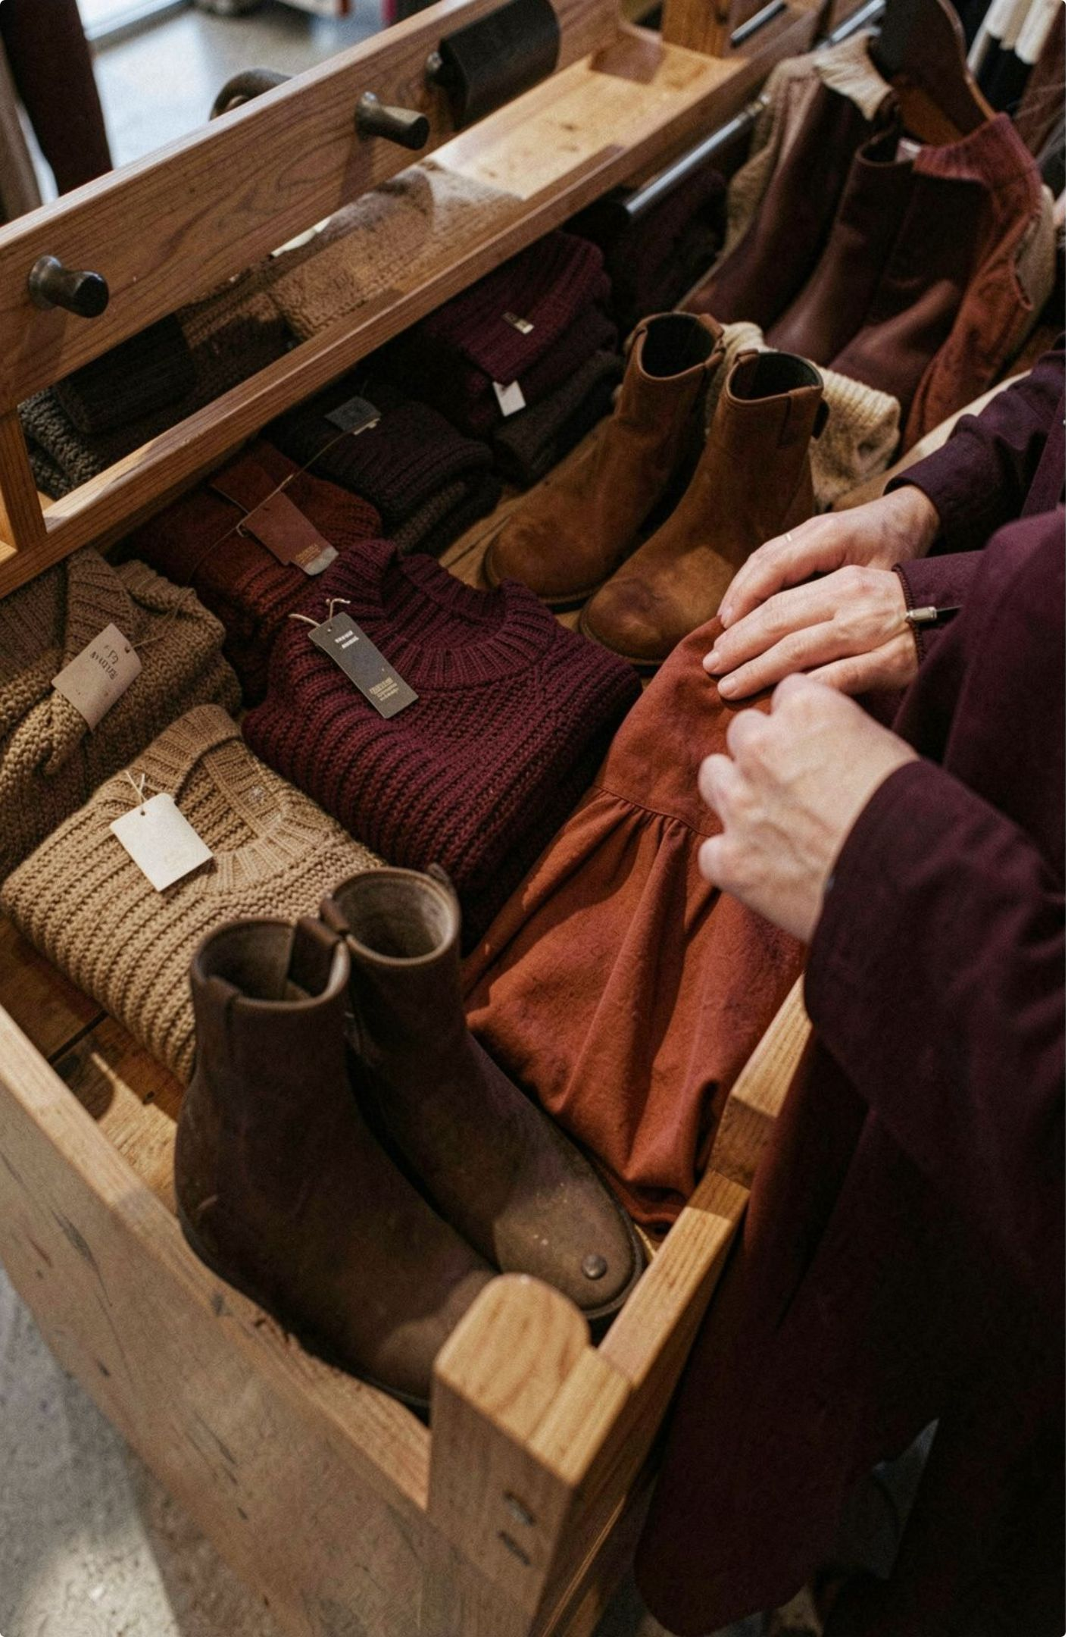
06 — NEXT PLANNING CYCLE
Three moves for the next planning cycle
Turn the readout into a sharper assortment and campaign plan.
01
Build fall stories
Center larger seasonal stories on clothing plus footwear pairings.
02
Protect breadth
Keep a portfolio of top item families rather than over-indexing on one SKU.
03
Weight the plan
Use category volume and seasonal spend together to set inventory and campaign weight.
Customer shopping behavior: the $60 center of gravity
7

Slide 8
07 — DATA NOTES
Data notes
A descriptive read of the supplied customer shopping behavior file.
Field | Note
Coverage | 3,900 purchase records across 50 U.S. states.
Available fields | Category, item, season, spend, rating, subscription status, payment method, and purchase frequency.
Interpretation | Figures shown are descriptive averages from the supplied file, not causal estimates.
SOURCE
Customer shopping behavior dataset · descriptive analysis for planning use
Customer shopping behavior: the $60 center of gravity
8

